Slide 1


TOURISM GUIDANCE
Guide- Priyanka Ghule
Group Members | Class & Roll Number
Sumeet Nikum | SE9 36
Dushyant Pande | SE9 38
Tanvi Rathod | SE9 46
Group – 34

Slide 2
Table Of Contents
Problem Statement
Introduction
Literature Review
Objectives
Scope
Facilities Required for Proposed Work
Layout
Conclusion
References

Slide 3
Problem Statement
To simplify user experience in travel and tourism.
To provide you best destination places depending upon your taste.

Slide 4
Introduction
Many businesses need a website now If you have a travel business but everything is being done by word of mouth, then it will not work for long.
Customers are interested in exploring every location on their own without any intervention of travel operators and with the development of high technological trends and the constantly growing digital landscape, no tour agency can have a single success without an online presence. Probably, this is the reason why the Net is full of travel websites.

Slide 5
Literature Review
Name of the paper | Work Done
IEEE XPLORE/2016 | This paper builds a tourist attraction tag system, which links tourists and tourist attractions through the tag from which the tourist will be able to know in a particular state which place is most rated by the visitors. Its purpose is to show the rating of the place with the help of the tag.
Veena World Website (www.veenaworld.com) | One stop website for International Travel.
Swastik Tours Website (www.swastiktours.com) | Direct links to all their famous tour packages from the main page.
Club Mahindra Website (www.clubmahindra.com) | Famous for its lavish properties in almost every location in India and abroad.

Slide 6
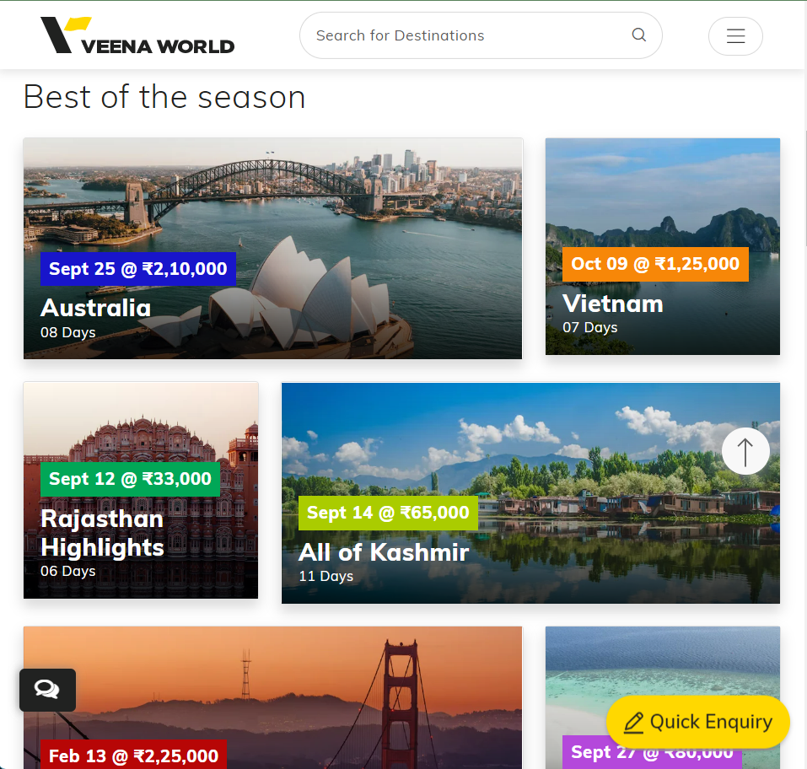
Veena World Website
Key Features:-
Displays famous packages at the very front.
Colorful and attractive.
Has relevant articles related to the travel scenario at the moment.
A clean user experience with great transition effects.
Well organized.
www.veenaworld.com

Slide 7
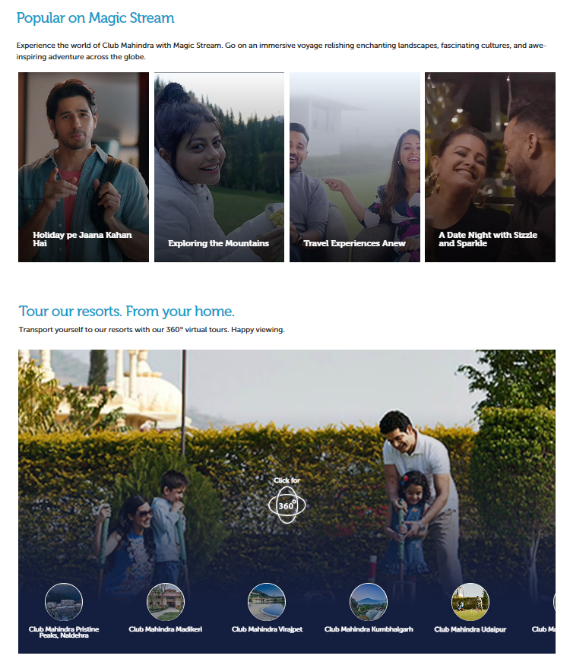
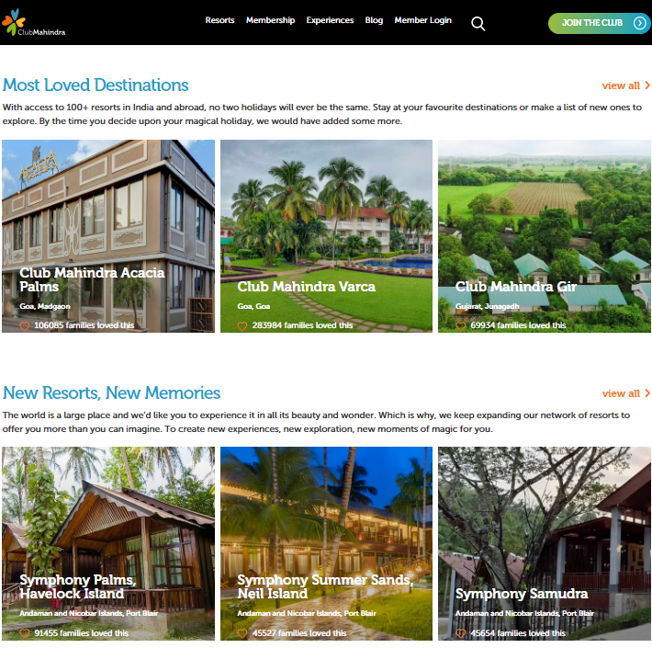
Club Mahindra Website
Key features:-
Display of new resorts on top.
Customer reviews and favorites.
Video advertisements.
360˚ view of their famous resorts.
Efficient marketing of their membership.
www.clubmahindra.com

Slide 8
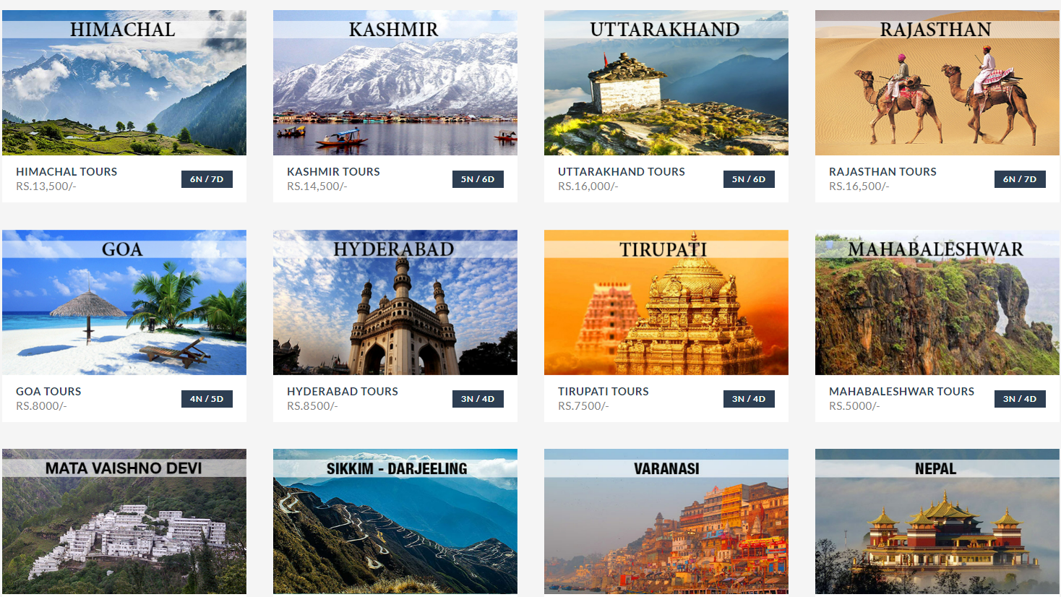
Swastik Tours Website
Key features:-
Direct links to all their famous tour packages from the main page.
Apt use of animations.
Minimalistic yet attractive.
Easy to navigate.
www.swastiktours.com

Slide 9
Objectives
Credibility
Visual Impact
Availability
Sales Promotion

Slide 10
Scope
Any travel agency can make use of it for saving costumer details.
Tourism group can make use of it for managing their locations and hotel details.
We will be putting an effort to provide the right choice to people when they plan a holiday.

Slide 11
Facilities required for proposed work
Visual Studio Code for writing HTML.
Visual Studio Code for writing CSS.
Visual Studio Code for writing JavaScript.

Slide 12
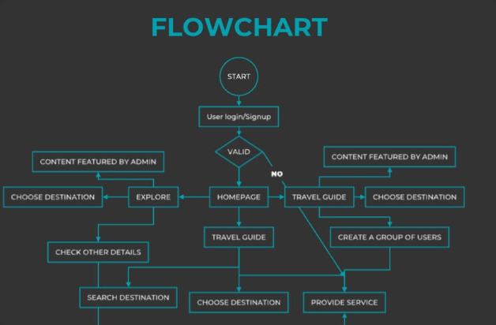
LAYOUT

Slide 13
PROBLEMS IN EXISTING WEBSITE
The website is difficult to traverse
Other website only provide information about famous places
Lack of animation
Agent charge commission of about 10-20% of gross amount
Not eye catchy

Slide 14
Conclusion
Tourist Guidance will provide the users with lot of information through photos & reviews of other travellers.
Using our website, will provide you more efficient, more convenient & the best travel experience ever.
Navigation through the site is easy.

Slide 15
References
Research on Personalized Tourist Attraction Recommendation based on Tag and Collaborative Filtering Yanqing Cui, Chuanlin Huang, Yanping Wang-IEEE XPLORE/2016
Veena World Website(www.veenaworld.com)
Swastik Tours Website(www.swastiktours.com)
Club Mahindra Website(www.clubmahindra.com)

Slide 16
Thank You!

